Slide 1
Cameras Used In Studio and On Location
Emily Serle and Joseph Gadd

Slide 2
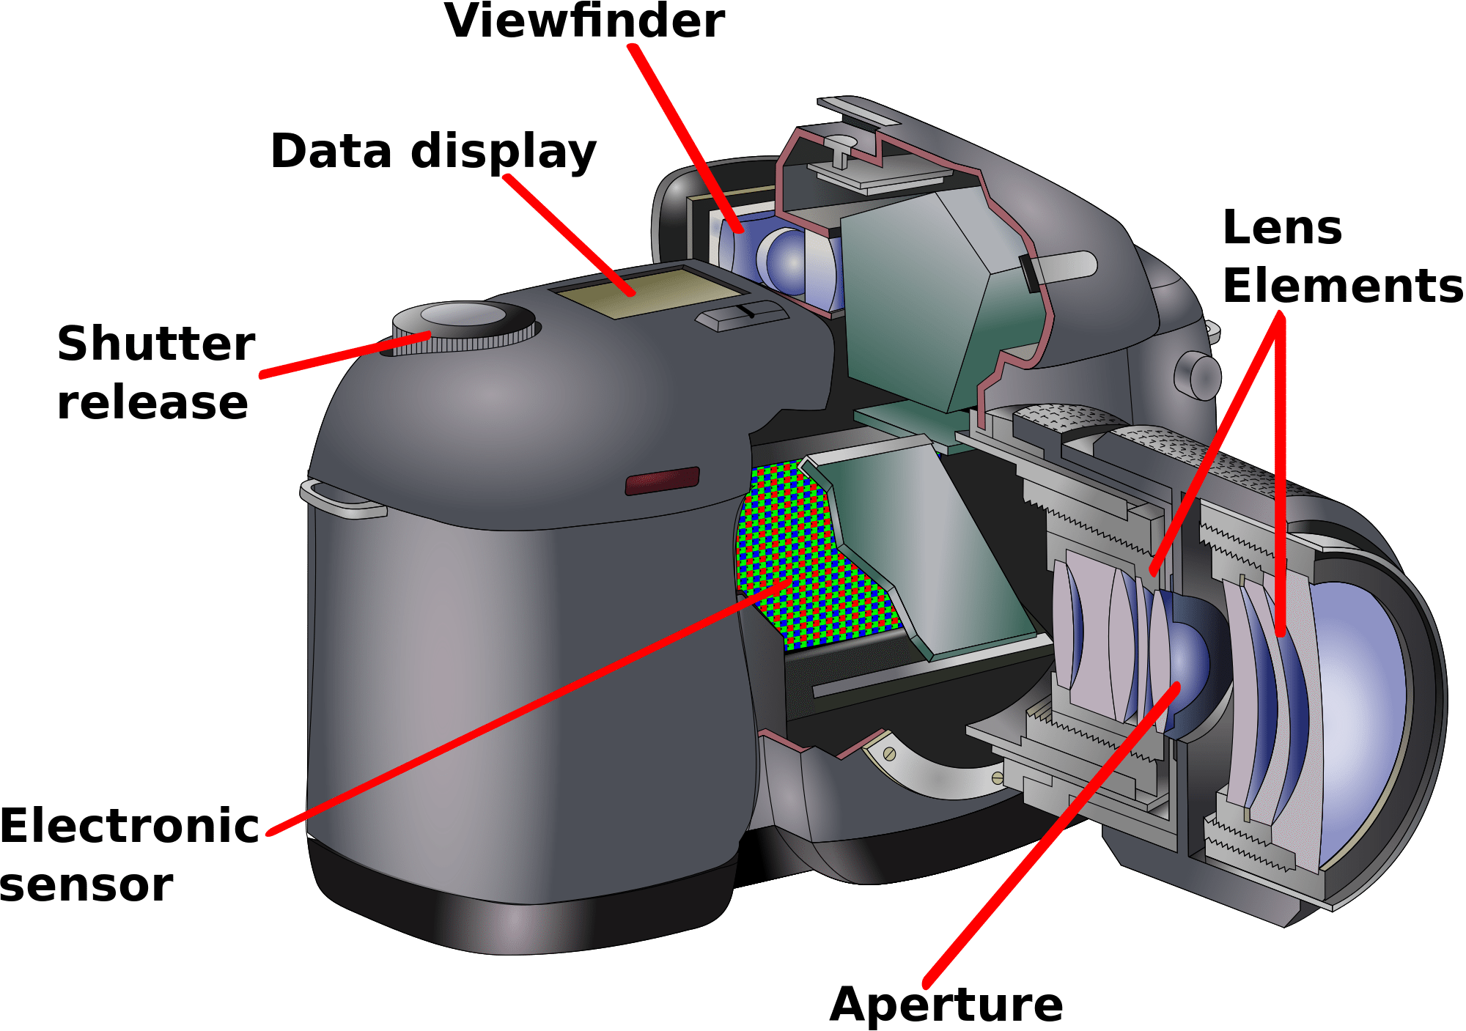
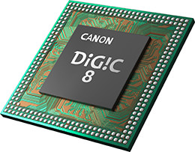
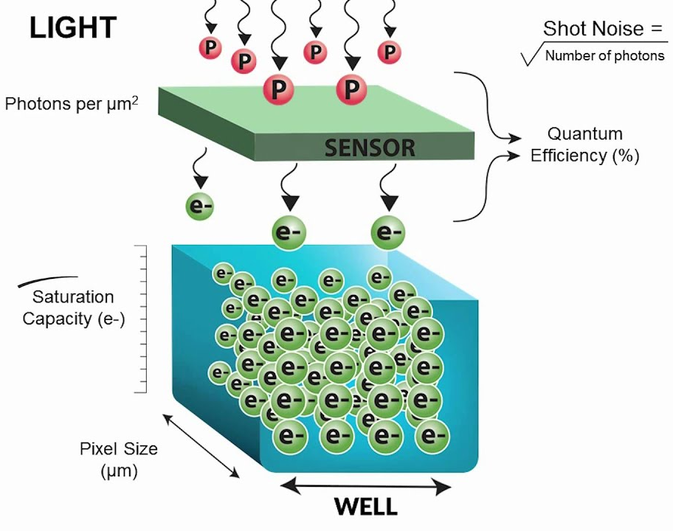
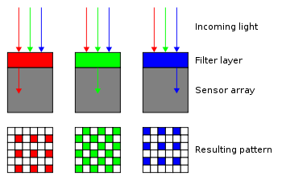
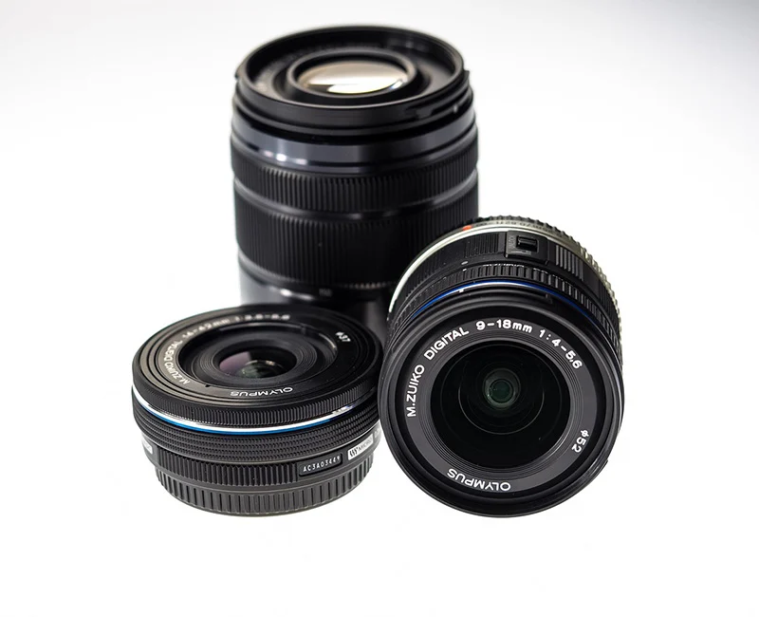
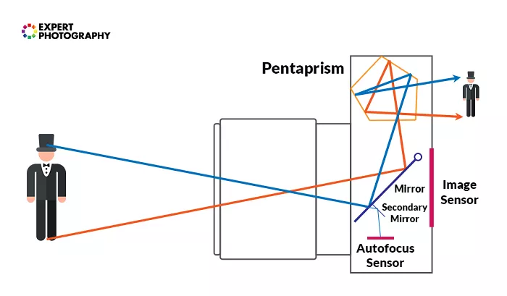
How Cameras work
Notes:
Light enters the camera through the lens, a piece of glass that has been shaped to direct the light in a specific way. For smaller cameras these are built into the camera body but for larger cameras, lenses are usually interchangeable based on the effect the photographer wants to achieve.
Most cameras have viewfinders to enable the photographer to see the image they will be capturing. These can be optical or electronic depending on the type of camera. For optical viewfinders, once the light has entered the lens, it hits a mirror that directs most of the light towards the viewfinder as seen in the diagram. For mirrorless cameras, a live view is transmitted digitally to the viewfinder.
When the shutter release button is pressed to take a photo, the shutter opens allowing the light to hit the camera sensor. The sensor then measures the intensity of light hitting the sensor and records it. The sensor is made up of individual pixels that each measure the intensity of light. They do this by detecting how many photons reach the pixel. This information is then recorded as a voltage value.
To record colour, each pixel needs a colour filter. The most common filter array is a bayer filter as can be seen in the image. There are more green filters since humans are more sensitive to green light. Some modified Bayer filters also incorporate clear filters where some green ones should be in order to improve the sensitivity of the sensor.
The camera processor takes all the information recorded by the sensor and uses it to build the image that we see. It converts the red, green, blue colour into natural colour by using information from neighbouring pixels. This is usually stored on a memory card so that images can be viewed on other devices.

Slide 3
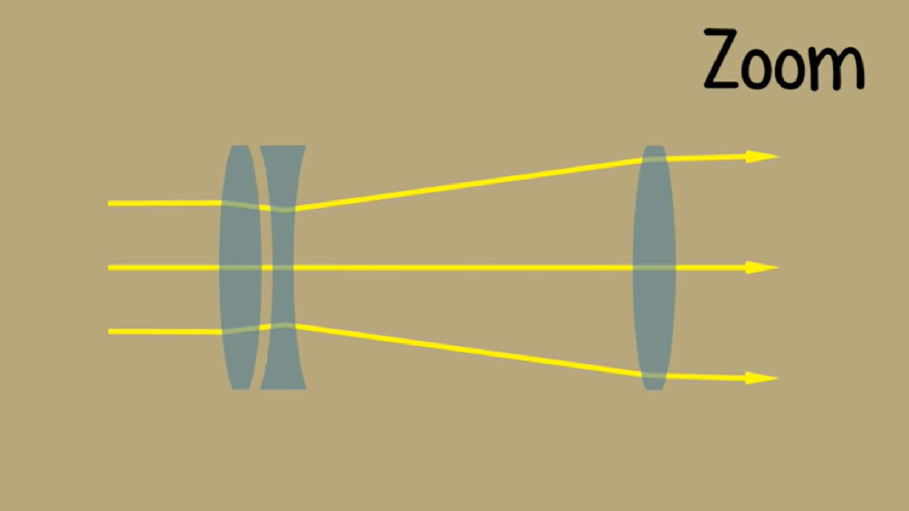
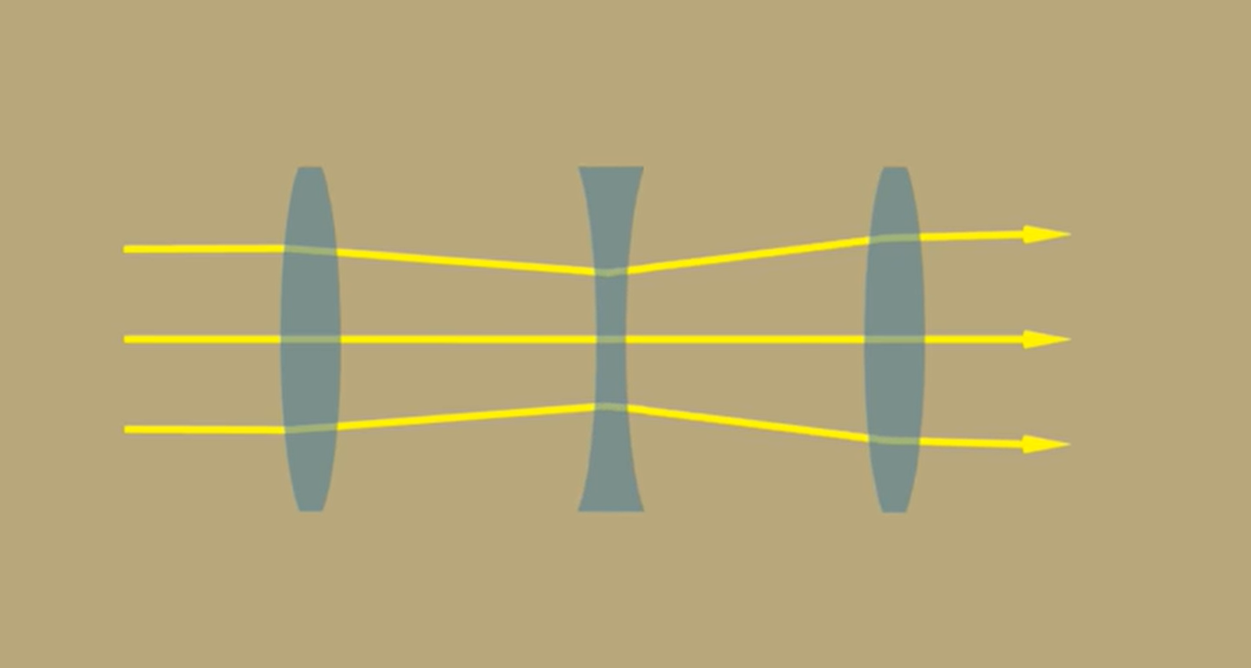
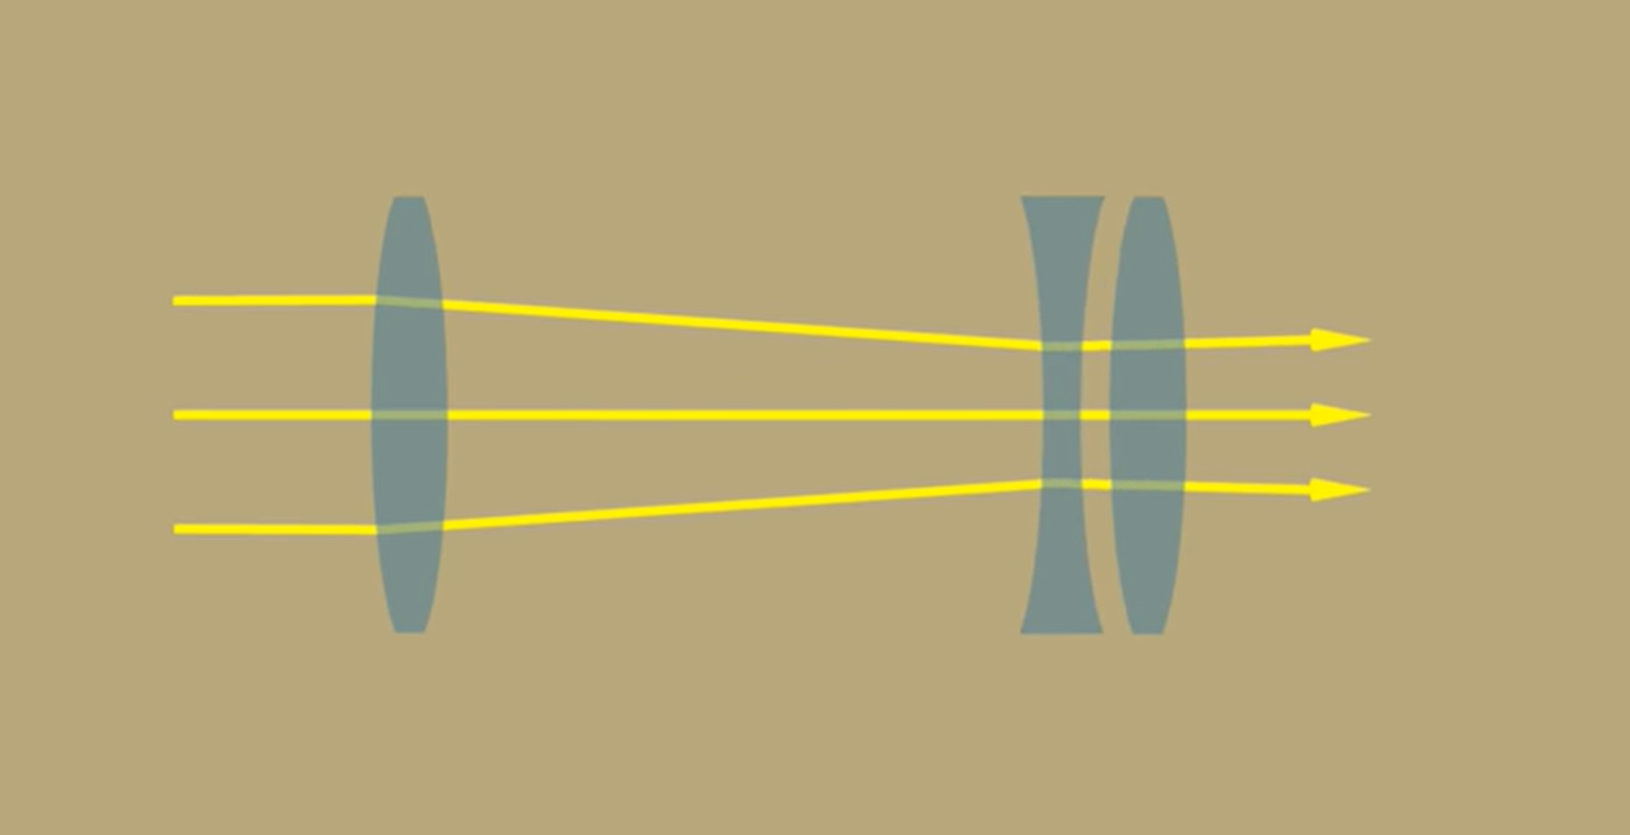
How Cameras work
Image profile can changed through the mechanical operation of the components.
Zoom
Focus
Exposure (Aperture, ISO, Shutter speed)
Depth of Field
Notes:
For the image characteristics in the list, generally some mechanical operation
Zoom
Optical: The zoom lens moves away from the sensor, diagrams (>>>>>), as zoom lens (concave) moves to the left, light rays reaching the sensor on the right are wider apart, resulting in a more zoomed in image
Digital: The enlargement of a section of an image, achieved by cropping, worse quality image than optical zoom
Focus
Adjusting the lenses to find maximum detail and sharpness in the subject of the image
Achieved by changing the focal length depending on the distance to the subject/changes with level of zoom
Can be done manually (usually twisting the lens) or using autofocus camera setting
Exposure
Overall brightness/darkness of an image, controlled by 3 parameters
Aperture:
Size of the opening before the lens, to let in more/less light, measured in f-stops
ISO:
Changing the sensitivity/signal gain of sensor, measured as a scale, low is dark, high is bright
High ISO results in more graininess to image
Shutter speed:
The time the camera shutter is open, letting in light. More time, brighter image
Tied to motion blur, more time open = more blur for moving subject, less time open = sharper “freeze framed” image
DoF
Distance between the closest and farther points that are in focus
Determined by aperture size, wider aperture results in shallow DoF, smaller the aperture the wider the DoF

Slide 4
Estimates suggest that more than 1 trillion photos are taken in a year. On average, 95 million photos are uploaded daily on instagram and over 300 million photos are uploaded to Facebook every day.

Slide 5
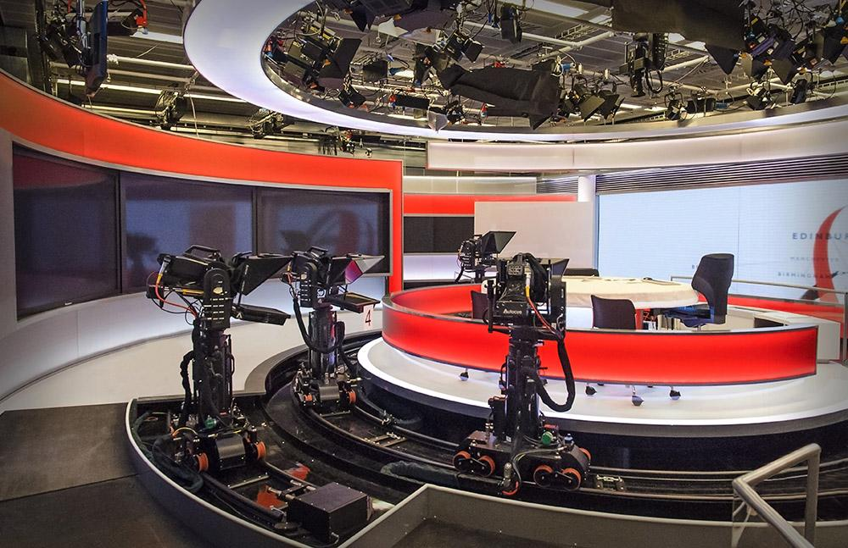
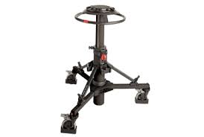
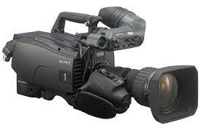
Studio Cameras
Why type of camera is used?
What is the camera connected to?
What type of sensor is used?
What format is the video in?
How does the camera move around?
Notes:
In a studio, high end professional video cameras are used, such as commonly used Sony HDC-4300 - £50,000
In a multi-camera set-up like most studios, the cameras are connected via triax or fibre optic to the CCU in the Apps room.
Through this cable video and audio are sent using frequency division multiplexing
The CCU (camera control unit) handles signals sent from the different studio cameras, and allows centralised control of camera parameters, via transmission back down the same triax cable, such as
Colour balance
Iris & Aperture control
Shutter speed
Black level
Allows camera operators to focus on camera positioning and image composition instead of camera settings
Triax also allows transmission of studio communication such as intercom and tally (signal that turns on red light that tells operator & presenter which camera is live at a given time)
Modern Studio cameras use a CMOS sensor, often with optical format of 2/3”, which indicates the size of the sensor and the resultant angle of view that the sensor can detect
Format Often HD 1920x1080, progressive scan, broadcast TV - 25 frames per second
Cameras also have an XLR port for an external microphone for recording the studio audio, as mentioned sent down triax with video feed
Number of different movement systems for studio cameras
Most common is the Ped (Pedestal) (>>>>>)
Camera is mounted on stand
Wheels with steering ring used to rotate wheels and move camera about
Dolly rail system (>>>>>)
Creates smooth horizontal camera movements and adjustments
Removes need for operator
BBC Automation Software: Mosart Automation
Studio camera are not normally handheld but can be in some situations

Slide 6
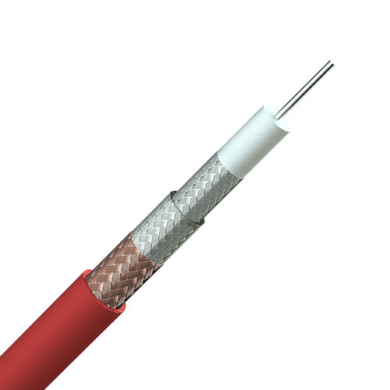
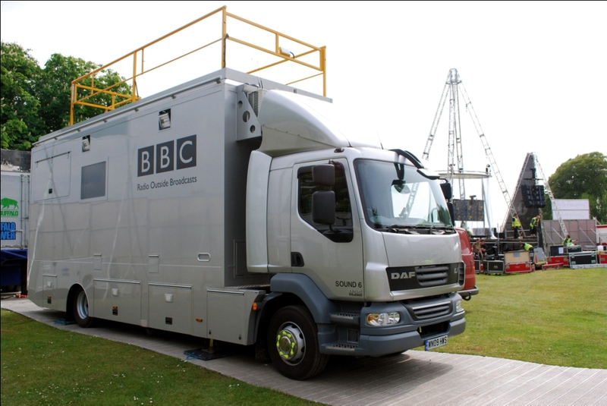
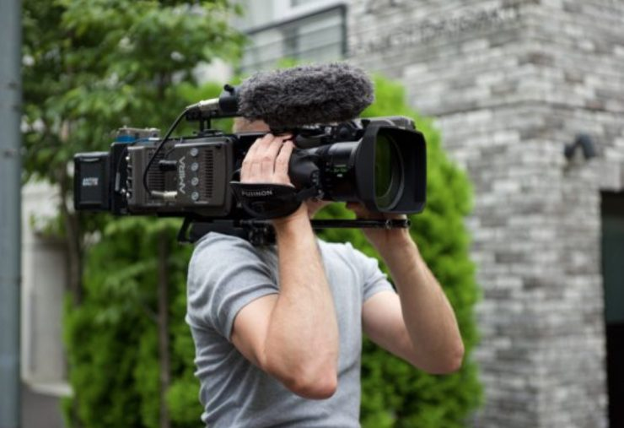
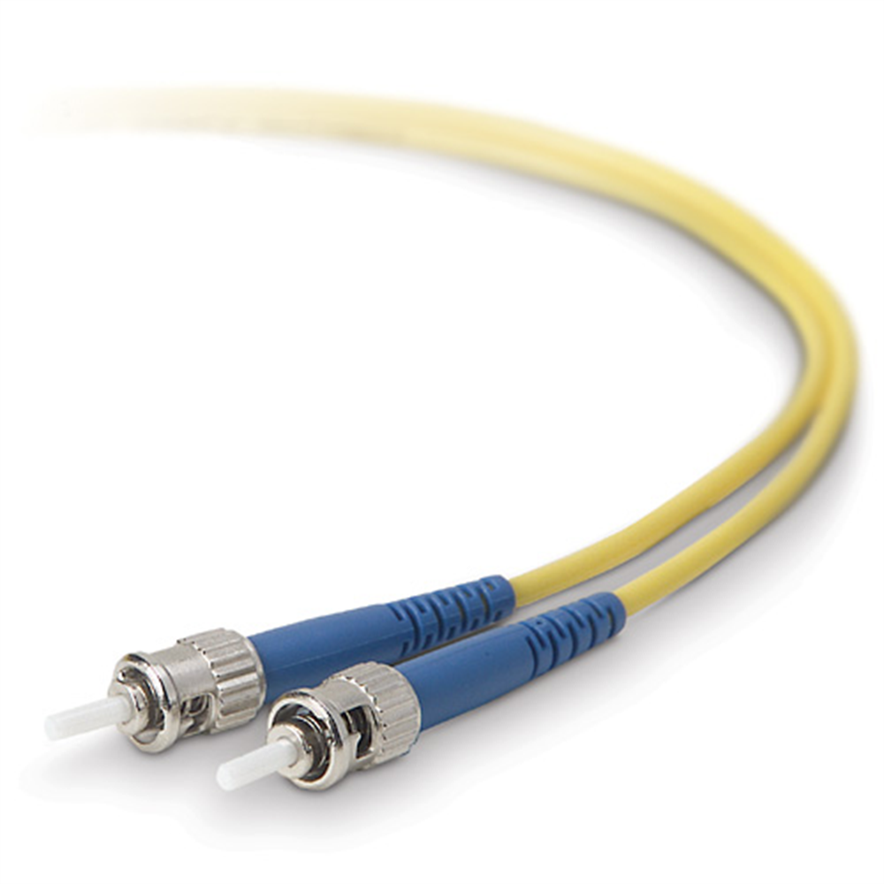
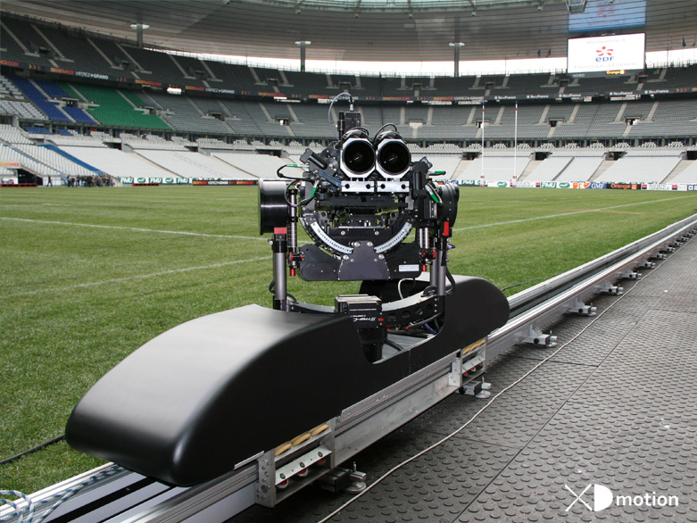
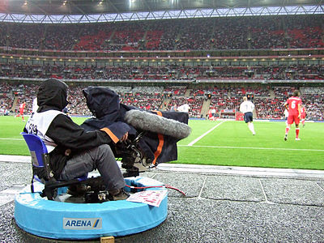
Outside Broadcast Cameras
Make/Model
Handheld/Freestanding/Movement
Sensor dimensions
Format
Cabling/Networking
Notes:
EFP cameras (Electronic field production cameras) are used for outside broadcasts. These cameras are very versatile. They can be carried around on the shoulder, or mounted on pedestals or cranes depending on the situation and what footage is needed. Most outside broadcasts use tripods to position the cameras as they are easy to set up and allow the camera to be moved about a point if needed.
>>>>>>
To film sports, cameras can be mounted on rails or pivots and controlled remotely by the operator to produce smoother footage as seen in the pictures above. Usually multiple cameras will have to be used in these situations to capture all the movement and at different angles.
>>>>>
Outside broadcasts need all the equipment used in the gallery for broadcasting but on a smaller scale so it is portable. An OB truck is fitted with all the equipment needed to process, record and transmit outside events.
>>>>>>
EFP cameras have no recording capabilities so have to be connected to the truck using either triax cables or fiber optic cables. Fiber optic cables can carry signals further, are small and lightweight and are immune to Electromagnetic and radio frequency interference but they are expensive in terms of equipment and labor. There are some large venues where permanent fiber optic infrastructure is feasible but for other smaller venues where filming takes place less often, it is too costly and impractical meaning they have to be installed and removed each time they are used. Fiber optic connectors can also be quite expensive Triax cables on the other hand are less expensive, more flexible and easy to fix if anything goes wrong.

Slide 7
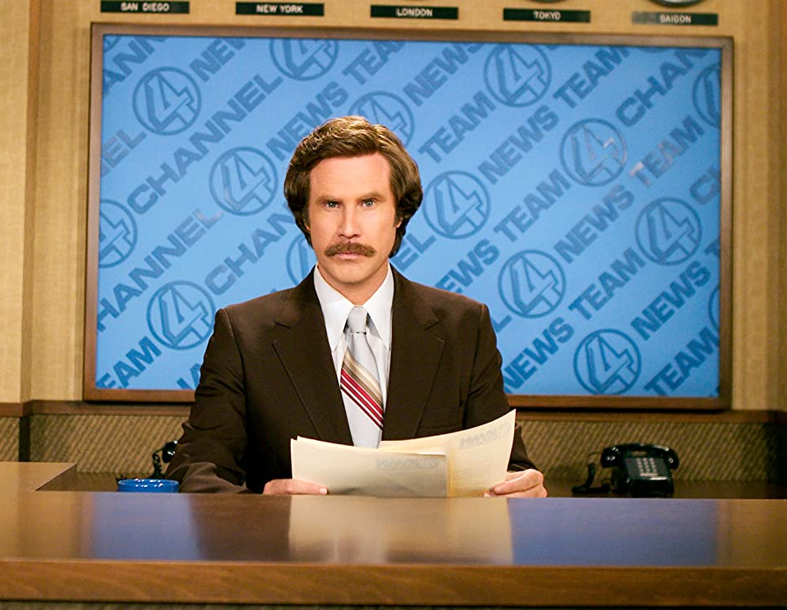
Thanks for listening!

Slide 8
Any Questions?

